Slide 1
1
Machine learning
Definition of Logistic Regression
Logistic Regression :
It is a classification algorithm
Response variable is in categorical form
It is used to find the relationship Between feature and probability of particular outcome.
Ex:when we are predicting the students passes or fails in an exam when the number of hours spent on studying is given as a feature ,where as the response variable has two values ,Pass and fail.

Slide 2
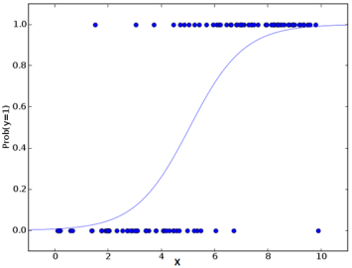
2
Machine learning
Function used in Logistic Regression
Sigmoid function used in logistic Regression ;Sigmoid function simply a mathematical function that takes on a characteristic “S” shaped curve
It tries to convert the independent variable into a expression of probability that ranges between 0-1 w.r.t dependent variable

Slide 3
3
Machine learning
Sigmoid Function
1)Equation of sigmoid function:
y = 1/1+e^-x
Where x=independent variable (That has to be transformed)
e=Natural logarithm base (Also known as Euler’s no)
e-=2.718

Slide 4
4
Machine learning
Applications of Logistic Regression
Applications.
Logistic regression is used in various fields, including machine learning, most medical fields, and social sciences.
Machine learning; in classification problem
In the biomedical field, data in binary form such as disease/no disease
Also frequently used in business analysis applications

